Slide 1
Just a little more…..
5 Professors Sue Rutgers, Saying It Shortchanges Women on Pay
The five women say they are paid tens of thousands of dollars less than men with similar qualifications. The university says it is “committed to pay equity.”
https://www.msnbc.com/opinion/we-re-just-beginning-understand-extent-covid-19-s-feminist-n1243401

Slide 2
Unsung Women Who Changed America
UNLADYLIKE2020 is a series of 26 short films and a one-hour documentary, profiling diverse and little-known American women from the turn of the 20th century, and contemporary women who follow in their footsteps. The series premiered in 2020 on PBS’s American Masters.
https://unladylike2020.com/

Slide 3
WOMEN AS LEADERS
Current research on women and leadership
What will it take for a woman to make a woman president?

Slide 4
The glass ceiling versus the sticky floor
Glass Ceiling: A metaphor used to represent an invisible barrier that keeps a given demographic from rising beyond a certain level in a hierarchy. The metaphor was first coined by feminists in reference to barriers in the careers of high-achieving women.
https://www.youtube.com/watch?v=Soudg5ZAVj0
Sticky floor: A metaphor representing where women somehow hold themselves back, either unwittingly or by design. Perhaps content to reach a certain level and to call it a day. Whose undoing is not so much “out there” but “in here”.
https://www.youtube.com/watch?v=tLKQezaz2IA&t=39s

Slide 5
2019 report from the Bureau of Labor Statistics
Five forces affecting the progress of professional female workers in the US:
Compensation
Parental leave
On the job training
Healthcare issues
Leadership

Slide 6
Asilomar Declaration and Call to Action on Women and Leadership
TABLE OF CONTENTS
Executive Summary
Introduction.
Section I: Increasing Equality in Power and Decision-Making
Section II: Helping Girls and Young Women Become Leaders
Section III: Expanding Leadership Education and Development Worldwide
Section IV: Advancing Women in Leadership
Section V: Identifying Critical Areas for Future Research
Conclusion
Appendix A: 2015 Report Contributors
Appendix B: 2013 Report Contributors
Appendix C: References

Slide 7
Handbook of Research on Gender and Leadership (Madsen (ed.) (2017)
The current status of women leaders worldwide
Leadership theories and advancing women
Individual motivators to lead
Gender based leadership challenges and barriers
Developing women leaders
“To truly understand women and leadership, we must first actually do more research on a variety of precursors that fall under the gender equality umbrella”

Slide 8
Handbook of Research on Gender and Leadership (Madsen (ed.) (2017)
https://www.youtube.com/watch?v=ymH5bVDE80E

Slide 9
Sylvia Bashevkin: (2018) National security and gender politics in superpower America
Jeanne Kirkpatrick - Ronald Reagan
Madeleine Albright - Bill Clinton
Condoleezzza Rice - George W. Bush
Hillary Rodham Clinton – Barack Obama

Slide 10
Sylvia Bashevkin: (2018) National security and gender politics in superpower America
Did women’s presence make a meaningful difference in the conduct of international affairs?
How might decisions made by these leaders illuminate assumptions about women as gentle seekers of peace and consensus?
To what ways have female decision makers acted in ways that advance women as a group?

Slide 11
Sylvia Bashevkin: (2018) National security and gender politics in superpower America
Met the definition of leadership
American women could command confidence
transcend the characteristics of routine leadership
Demonstrated transformational leadership

Slide 12
Concept | Transactional Leadership | Transformational Leadership
Definition | Leader lays emphasis on his relationship with followers. | Leader lays emphasis on the values, ideals, morals and needs of the followers.
Nature | Reactive | Proactive
Best suited for | Settled Environment | Turbulent Environment
Works for | Developing the existing organizational culture. | Changing the existing organizational culture.
Style | Bureaucratic | Charismatic
How many leaders are there in a group? | Only one | More than One
Focused on | Planning and Execution | Innovation
Motivational tool | Attracting followers by putting their own self-interest in the first place. | Stimulating followers by setting group interest as a priority.

Slide 13
Sylvia Bashevkin: (2018) National security and gender politics in superpower America
Kirkpatrick - international doctrine of the first Reagan mandate
Albright - the pursuit of multilateral interventions in the Balkans.
Rice - main architect of Bush foreign policy
Hillary Clinton - shape Obama-era responses to the Arab Spring uprising in Libya.

Slide 14
Kirkpatrick – Albright – Rice - Clinton
Leadership traits
Aware of politics
Involved with activities that fostered confidence and risk
Activities with men and boys
Inner strengths
Academic credentials
Communication styles

Slide 15
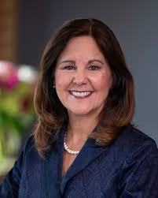
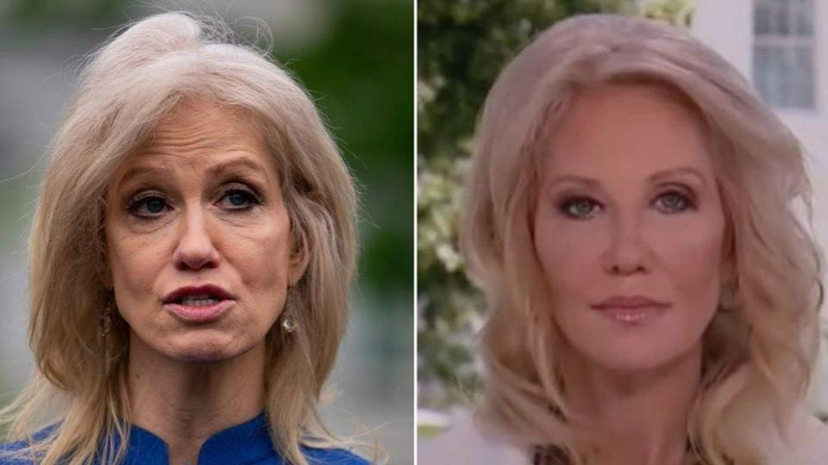
The stunning transformation of Karen Pence - She Really Has Had a Total
Makeover”: Karen Pence’s Transformation Is a Play for 2024
Kellyanne Conway Is Gorgeous After Glow-Up — Did She Have Plastic
Surgery?
Kamala Harris Fan to Undergo Plastic Surgery to Look Like Vice Presidential Nominee

Slide 16
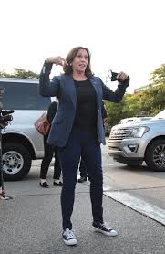
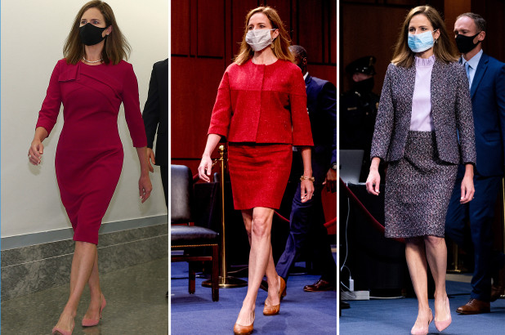
Kamala Harris’s Converse and the Political Evolution of the Sneaker - A Running List Of Times Kamala Harris Wore Converse
How Amy Coney Barrett dressed to impress women at SCOTUS hearings: Fashion expert says nominee used 'feminine' colors and 'alluring' silhouettes while fielding questions on abortion rights and Catholic beliefs

Slide 17
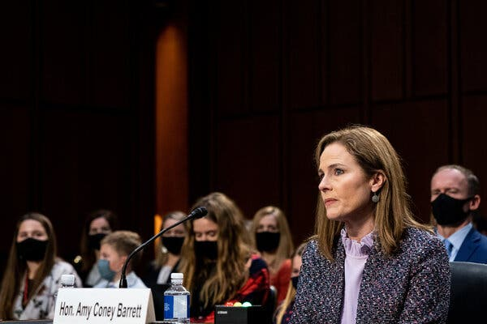
Why ‘Supermom’ Gets Star Billing on Résumés for Public Office
Judge Barrett and Senator Harris negotiate America’s freighted expectations for women.
Senator Kamala Harris accepting the Democratic nomination for vice president in August. She mentioned her role as a stepmother called Momala
Several of Amy Coney Barrett’s seven children were among the spectators at their mother’s Supreme Court nomination hearing this week

Slide 18
Women running for politics
https://www.youtube.com/watch?v=9RQ4RpO_KDw
https://www.youtube.com/watch?v=GICS2uUGvTE
https://www.youtube.com/watch?v=-9I9n4tlb24
https://www.youtube.com/watch?v=tnxZOIVA3oE

Slide 19
Marianne Schnall (2013) What will it take to make a woman president?
Country systemically disenfranchised women
Women are not taught risk-taking
Leadership has a male gender
political socialization of women
The more successful a woman is the less likeable she is perceived
Dealing with appearance and temperament

Slide 20
Marianne Schnall (2013) What will it take to make a woman president?
Perception that leadership requires a man
Gender difference arguments
Access to resources (money and support ) in politics
Juggling work and family
Not subjecting family to “that”
Role of wife and mother still seen as primary role

Slide 21
Marianne Schnall (2013) What will it take to make a woman president?
Socialize women differently
Grow the pipeline of women
Media portrayal of diversity versus beauty, youth, and sexuality
Support from other women
Teach young girls to develop courage
Stop labeling masculine or feminine

Slide 22
Marianne Schnall (2013) What will it take to make a woman president?
Women are detached from politics
Women need to know their power
Reframe ideas from being “women’s issues”

Slide 23
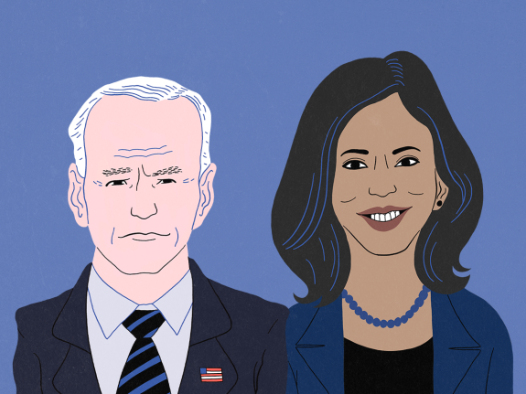
Could Kamala Harris Win The Presidency In 2024?

Slide 24
VICE PRESIDENT | PARTY | WON NOMINATION | WON PRES. ELECTION
Alben Barkley | D
Richard Nixon* | R | ✓ | ✓
Lyndon Johnson† | D | ✓ | ✓
Hubert Humphrey | D | ✓
Gerald Ford† | R | ✓
Walter Mondale | D | ✓
George H.W. Bush | R | ✓ | ✓
Dan Quayle | R
Al Gore | D | ✓
Joe Biden | D | ✓

Slide 25
There’s a special place in hell for women who don’t help other women
Madeleine Albright

Slide 26
From the Elders of the Hopi Nation
Oraibi, Arizona, June 8, 2000
To My Fellow Swimmers:
Here is a river flowing now very fast. It is so great and swift that there are
those who will be afraid, who will try to hold on to the shore. They are
being torn apart and will suffer greatly.
Know the river has its destination. The elders say we must let go of the
shore, push off into the middle of the river and keep our heads above water.
And I say see who is there with you and celebrate. At this time in history,
we are to take nothing personally, least of all ourselves. For the moment
that we do, our spiritual growth and journey comes to a halt.
The time of the lone wolf is over. Gather yourselves. Banish the word
struggle from your attitude and your vocabulary.
All that we do now must be done in a sacred manner and in celebration.
For we are the ones we have been waiting for.

